Slide 1
Object Detection
Slide courtesy: S. Lazebnik, D. Hoiem

Slide 2
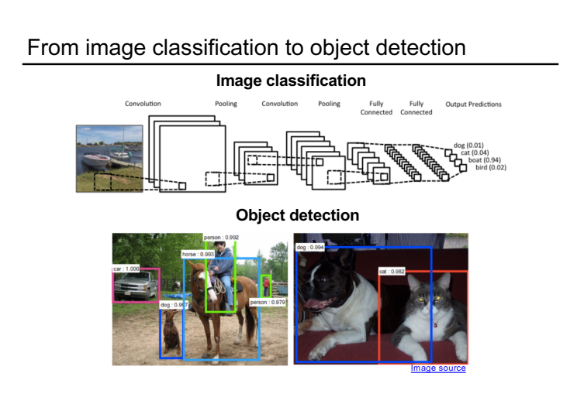

Slide 3
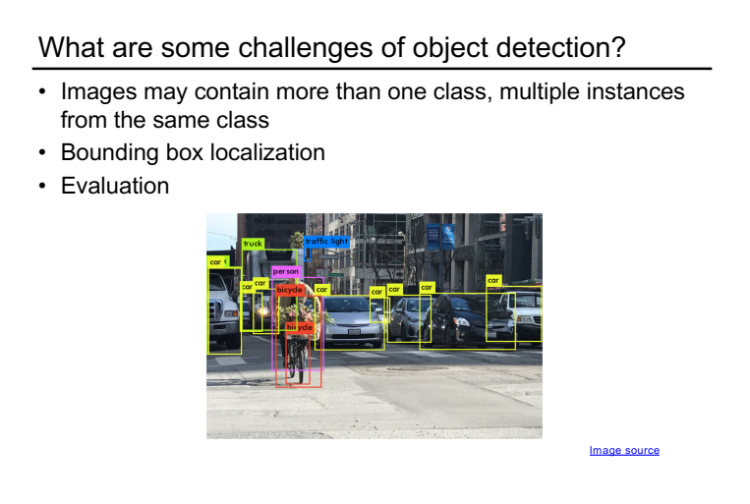

Slide 4
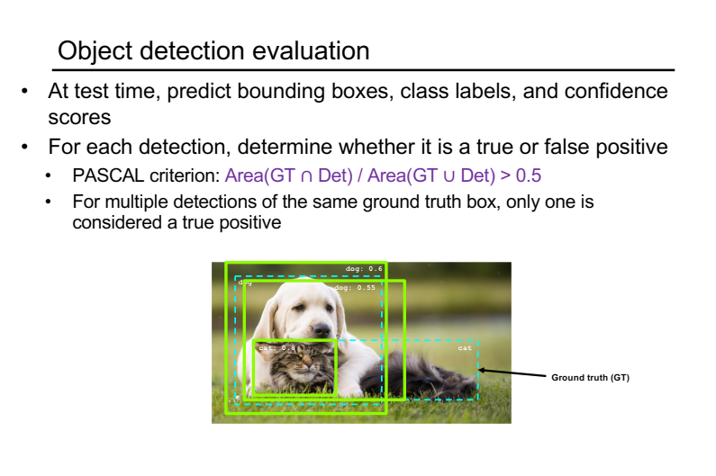

Slide 5
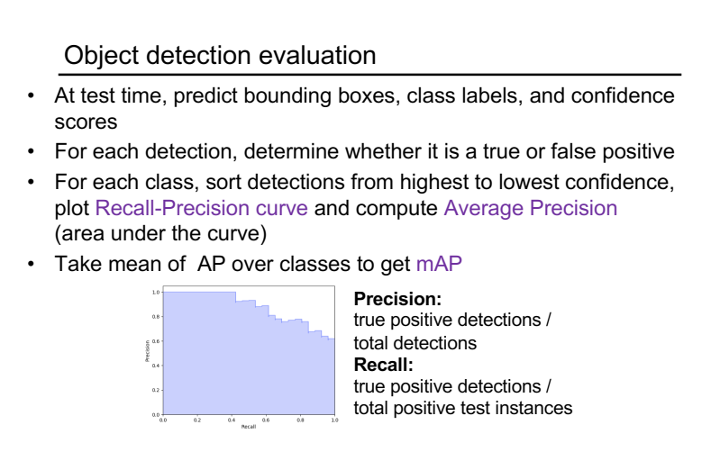

Slide 6
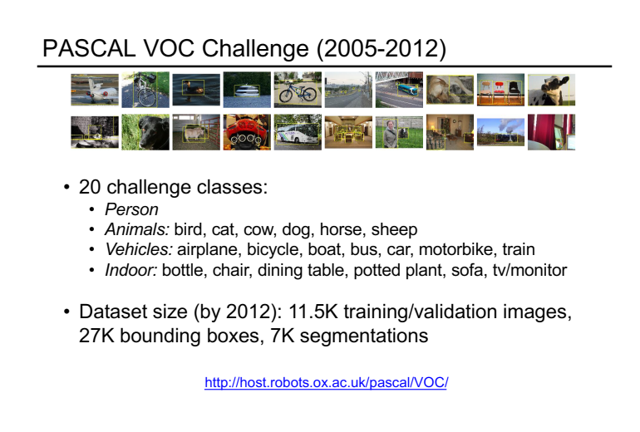

Slide 7
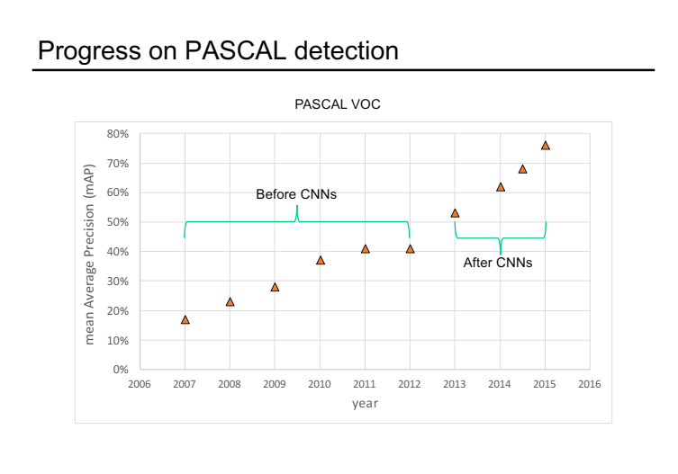

Slide 8
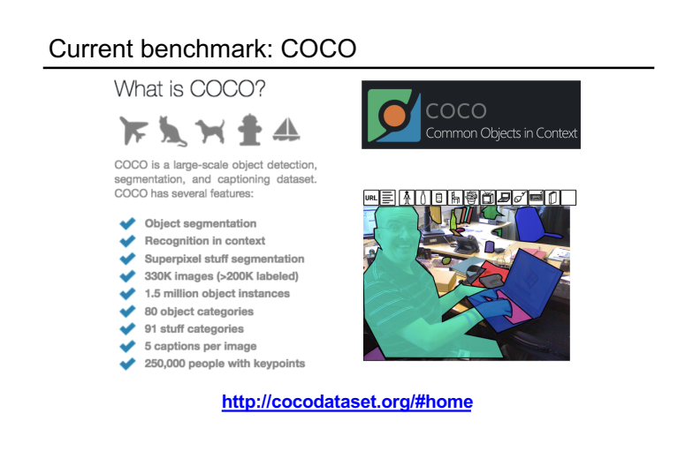

Slide 9
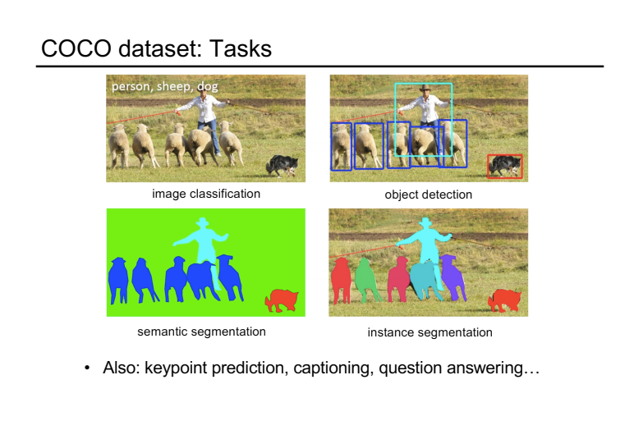

Slide 21
AdaBoost Algorithm
Given: m examples (x₁, y₁), …, (x_{m}, y_{m}) where x_{i}∈X, y_{i}∈Y={-1, +1}
Initialize D₁(i) = 1/m
The goodness of h_{t} is calculated over D_{t} and the bad guesses.
For t = 1 to T
1. Train learner h_{t} with min error
The weight Adapts. The bigger ε_{t} becomes the smaller α_{t} becomes.
2. Compute the hypothesis weight
3. For each example i = 1 to m
Boost example if incorrectly predicted.
Output
Z_{t} is a normalization factor.
Linear combination of models.

Slide 33
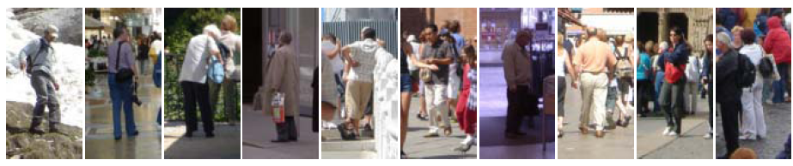
Example: Dalal-Triggs pedestrian detector
Extract fixed-sized (64x128 pixel) window at each position and scale
Compute HOG (histogram of gradient) features within each window
Score the window with a linear SVM classifier
Perform non-maxima suppression to remove overlapping detections with lower scores
Navneet Dalal and Bill Triggs, Histograms of Oriented Gradients for Human Detection, CVPR05

Slide 34
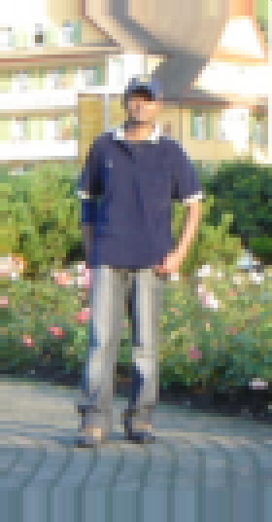
Slides by Pete Barnum
Navneet Dalal and Bill Triggs, Histograms of Oriented Gradients for Human Detection, CVPR05

Slide 35
Tested with
RGB
LAB
Grayscale
Gamma Normalization and Compression
Square root
Log
Slightly better performance vs. grayscale
Very slightly better performance vs. no adjustment

Slide 36
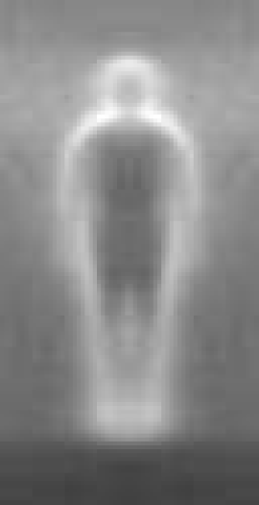

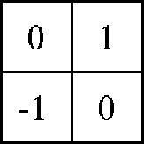

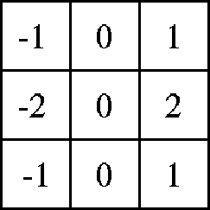

Outperforms
centered
diagonal
uncentered
cubic-corrected
Sobel
Slides by Pete Barnum
Navneet Dalal and Bill Triggs, Histograms of Oriented Gradients for Human Detection, CVPR05

Slide 37
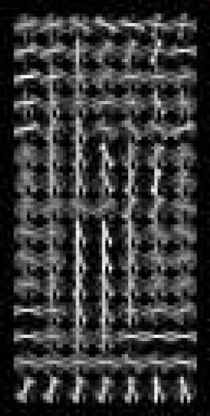
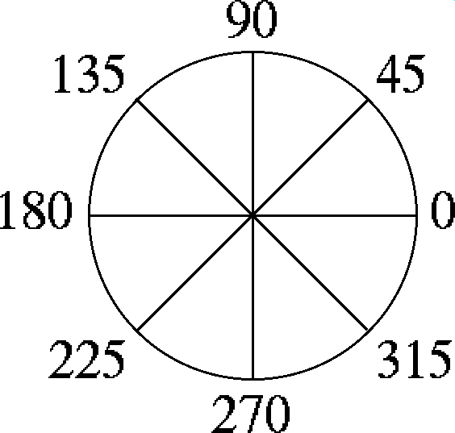
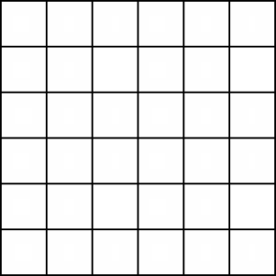
Histogram of gradient orientations
Votes weighted by magnitude
Bilinear interpolation between cells
Orientation: 9 bins (for unsigned angles)
Histograms in 8x8 pixel cells
Slides by Pete Barnum
Navneet Dalal and Bill Triggs, Histograms of Oriented Gradients for Human Detection, CVPR05

Slide 38
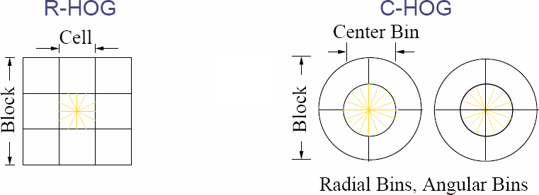
Normalize with respect to surrounding cells
Slides by Pete Barnum
Navneet Dalal and Bill Triggs, Histograms of Oriented Gradients for Human Detection, CVPR05

Slide 39
# orientations
# features = 15 x 7 x 9 x 4 = 3780
X=
# cells
# normalizations by neighboring cells
Slides by Pete Barnum
Navneet Dalal and Bill Triggs, Histograms of Oriented Gradients for Human Detection, CVPR05

Slide 40
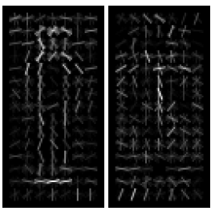
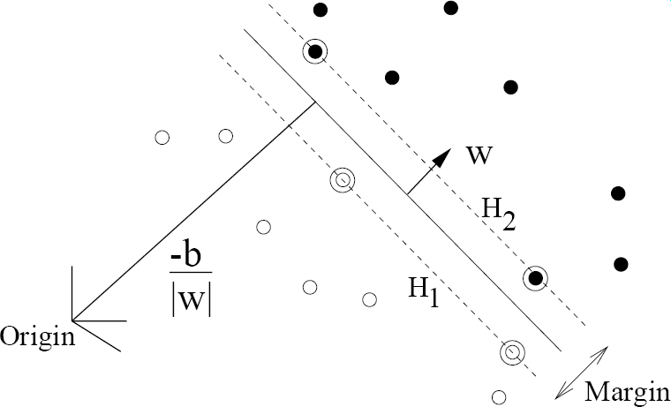
pos w
neg w
Slides by Pete Barnum
Navneet Dalal and Bill Triggs, Histograms of Oriented Gradients for Human Detection, CVPR05

Slide 41
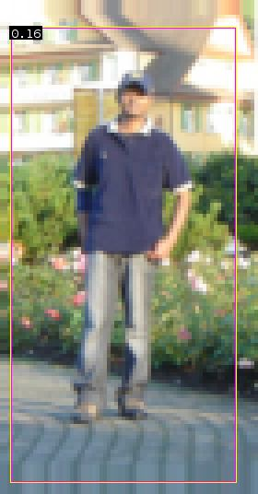
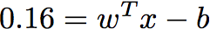
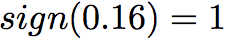
pedestrian
Slides by Pete Barnum
Navneet Dalal and Bill Triggs, Histograms of Oriented Gradients for Human Detection, CVPR05

Slide 42
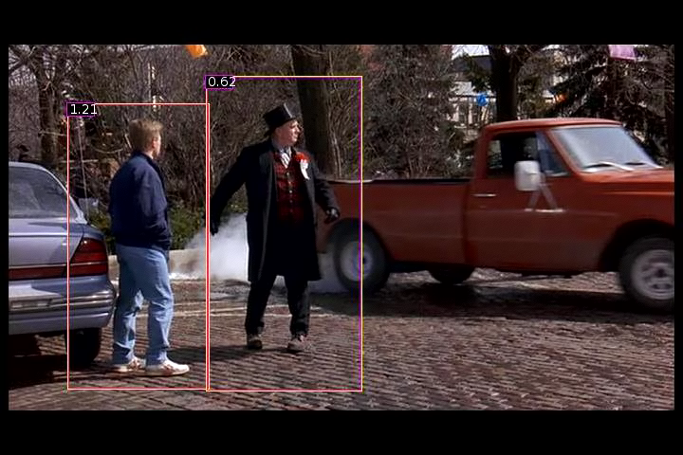
Detection examples

Slide 43
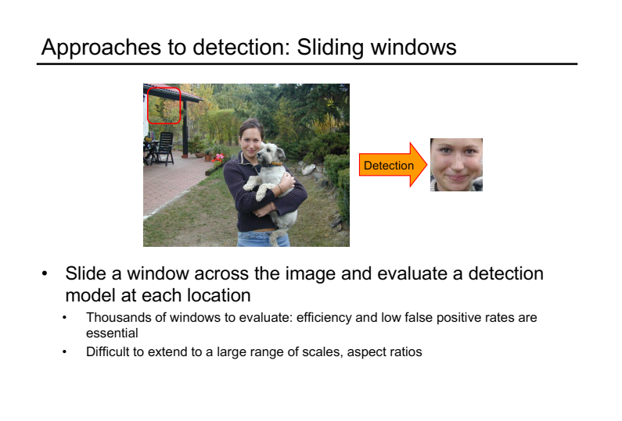

Slide 44
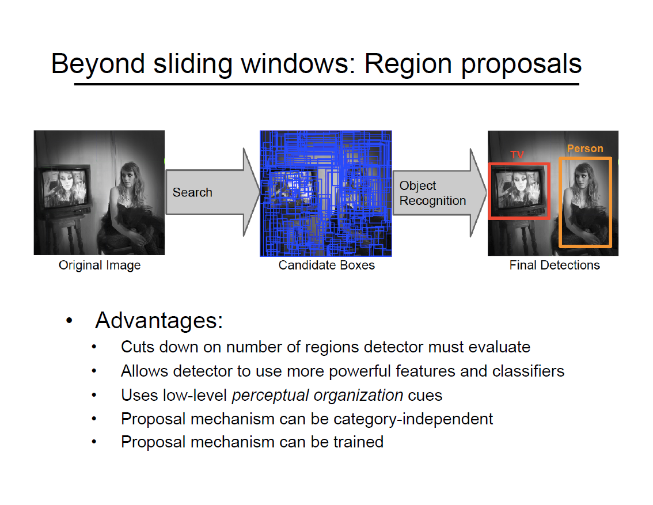

Slide 45
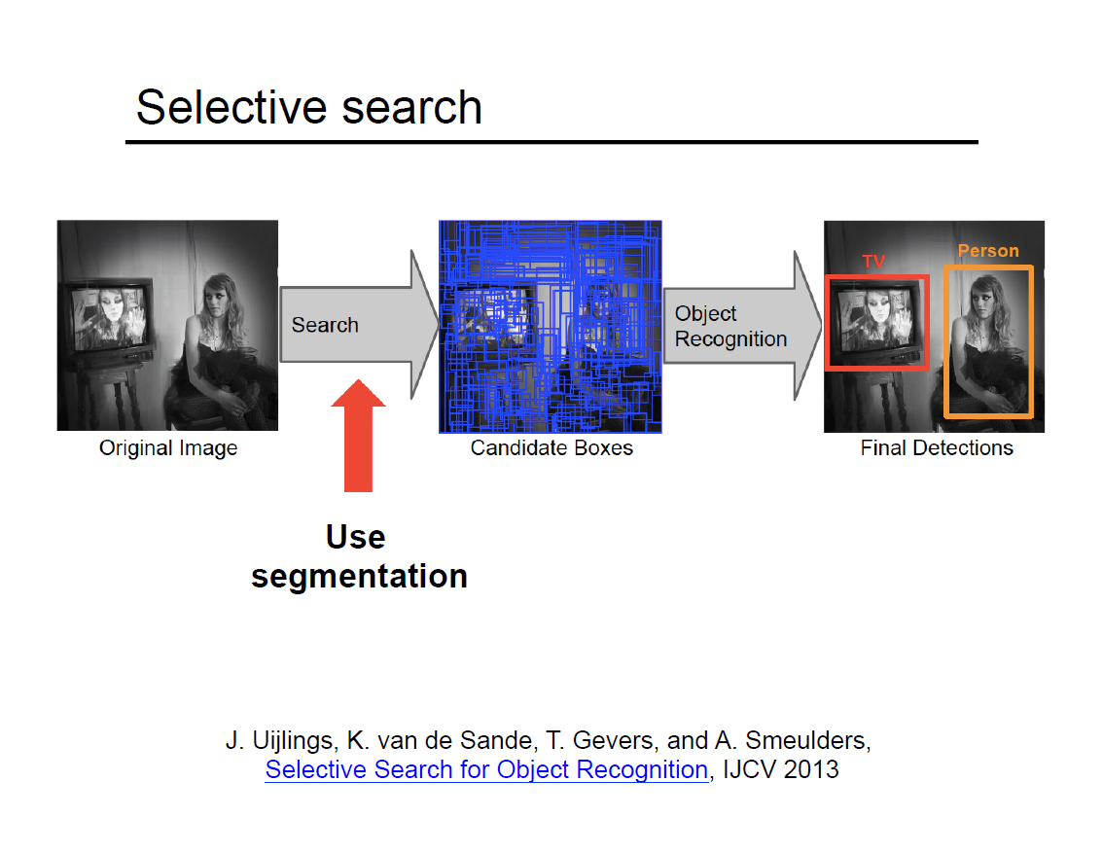

Slide 46
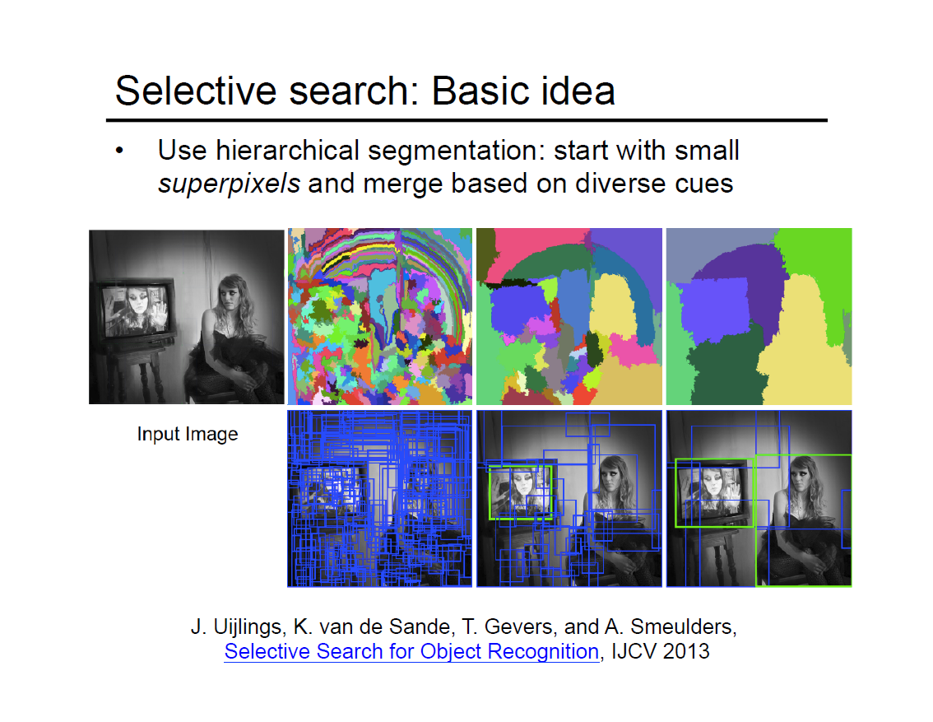

Slide 47
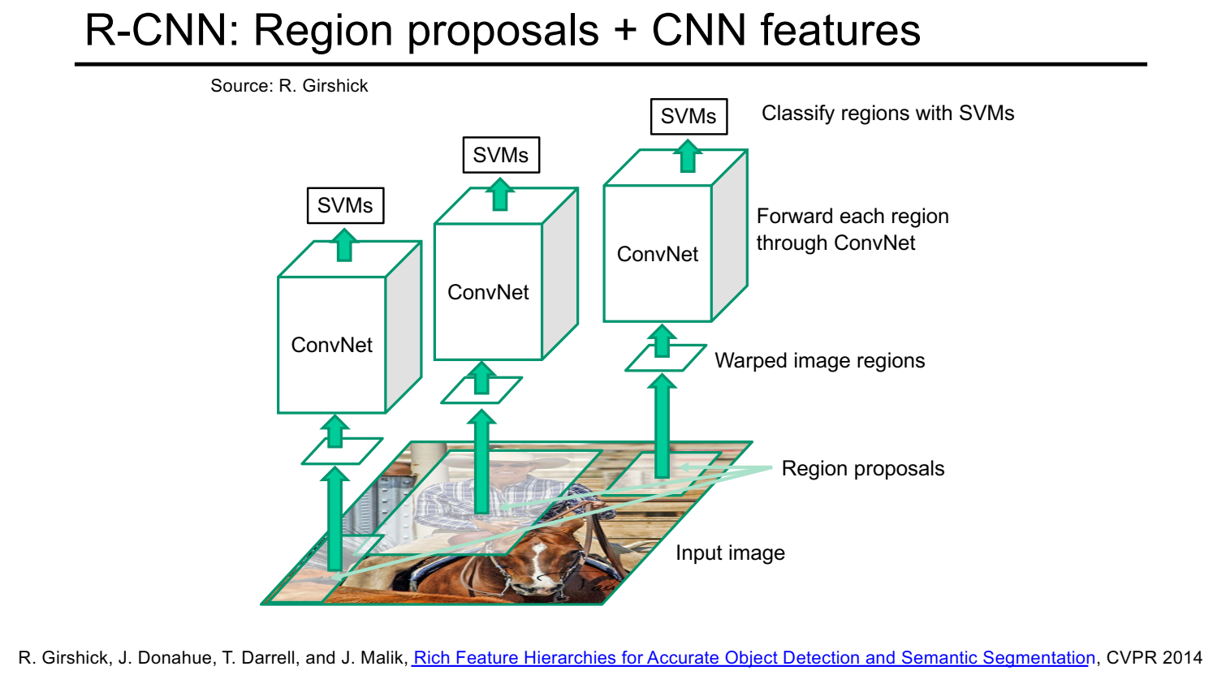

Slide 48
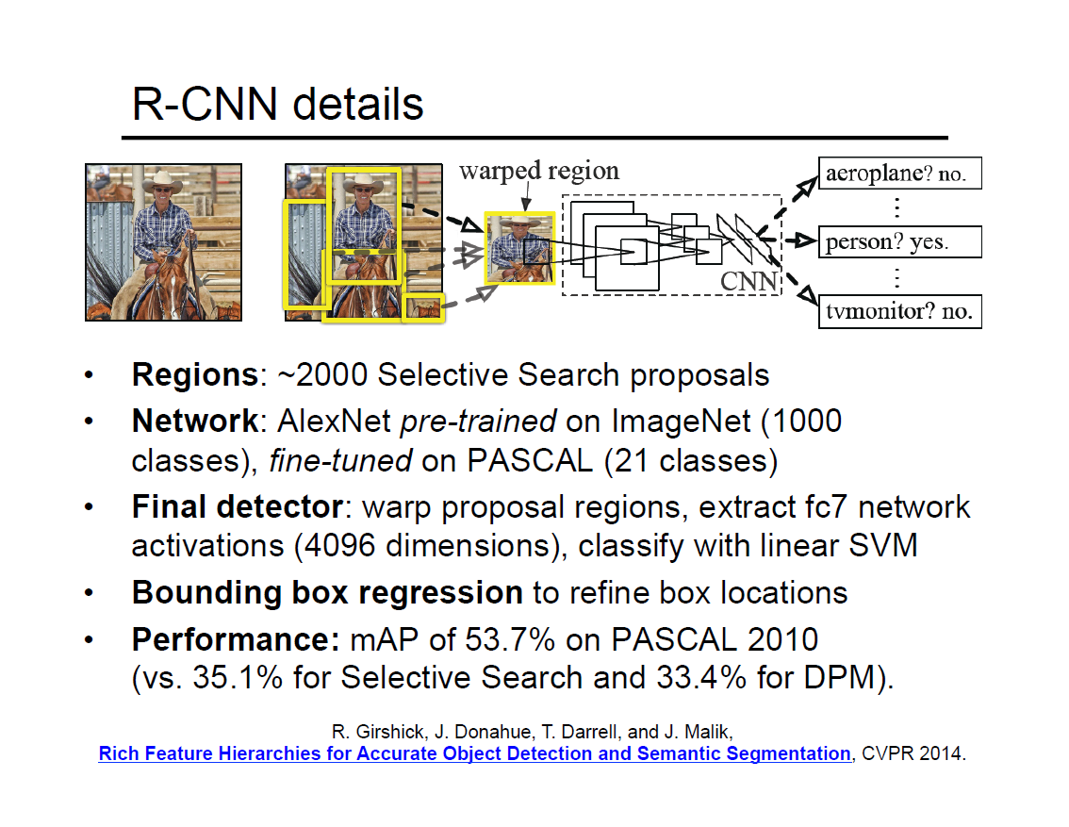

Slide 50
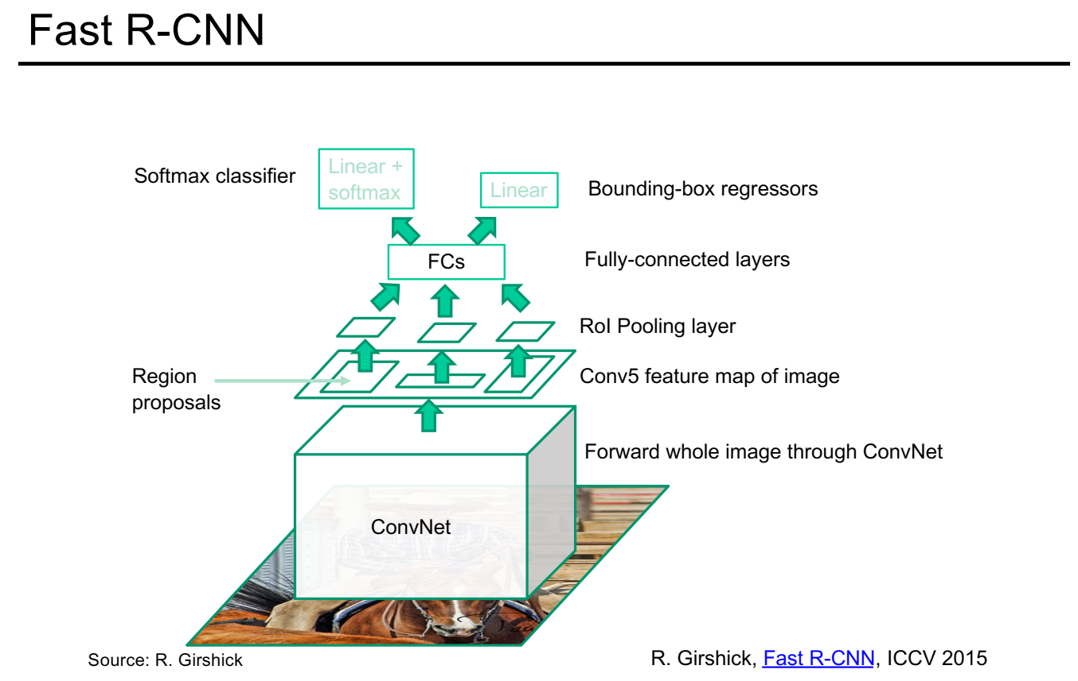

Slide 51
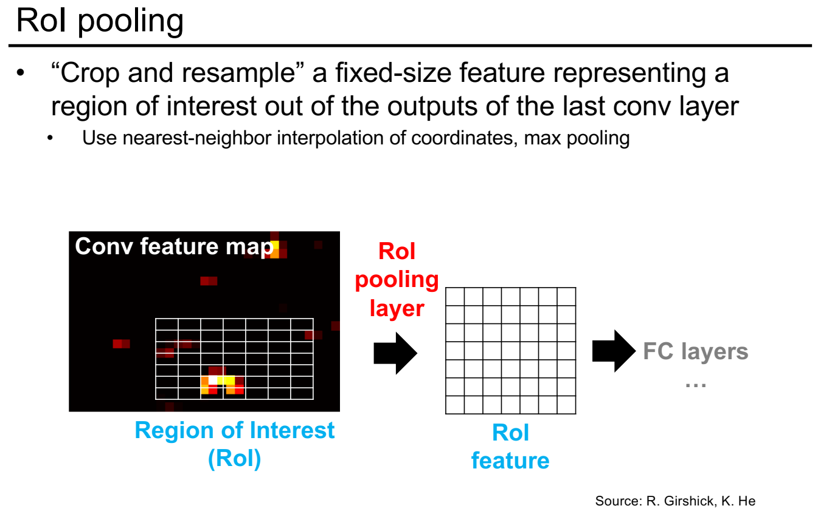

Slide 52
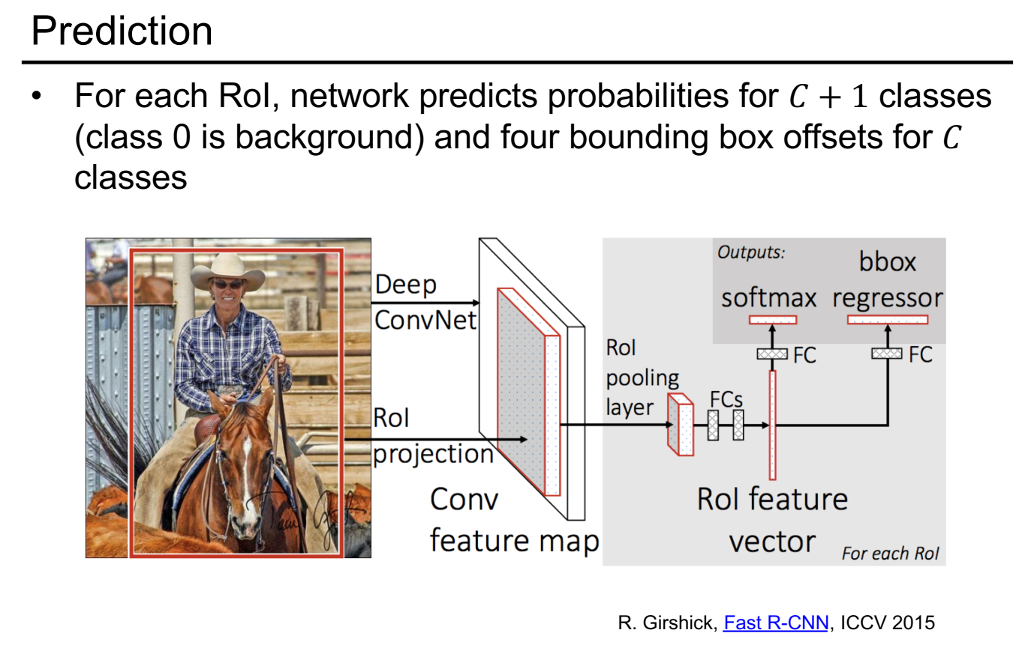

Slide 53
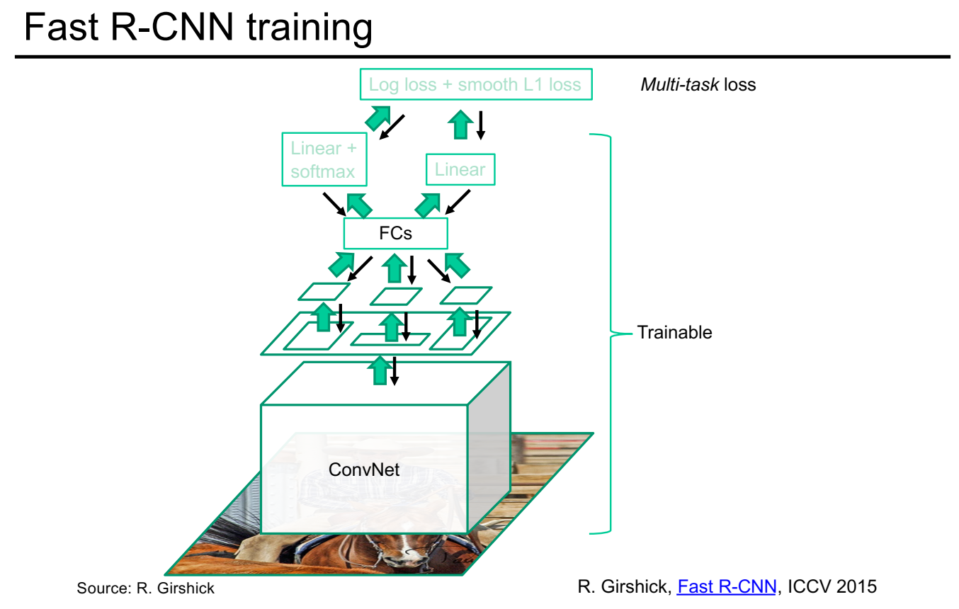

Slide 55
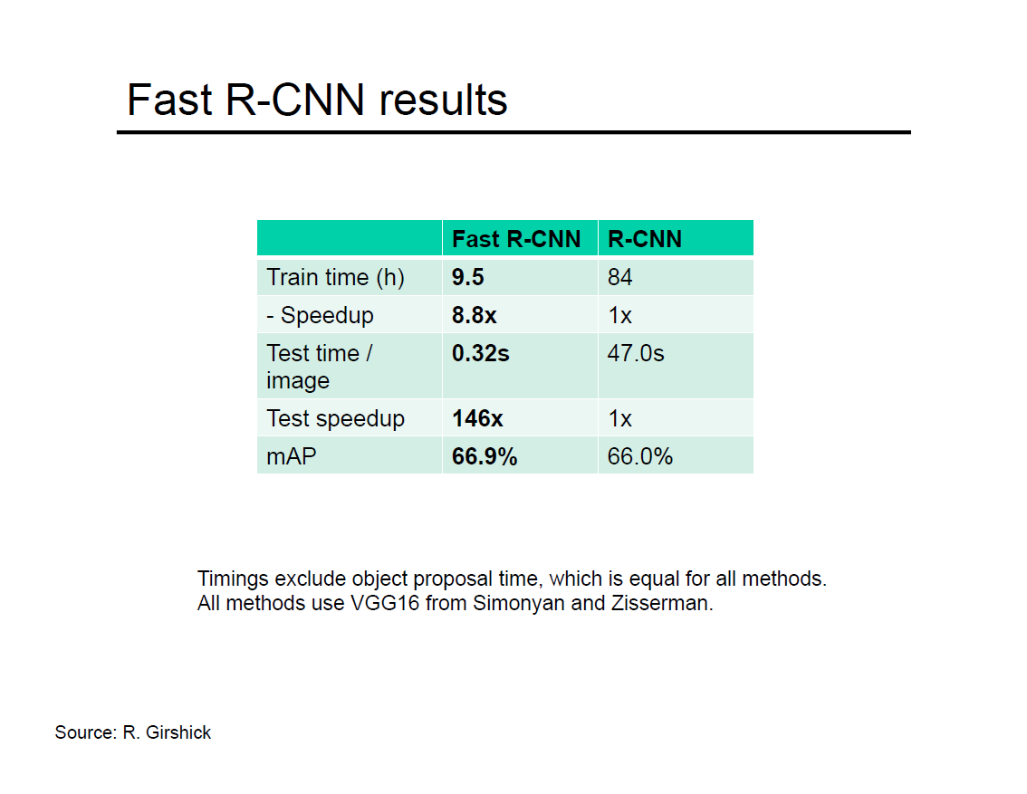

Slide 56
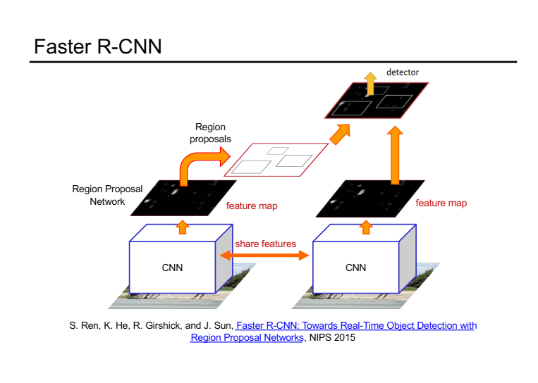

Slide 60
